Slide 1

CS6120 Project Proposal:
Identifying and Classifying Toxic Online Behavior
Under Prof. Prashant Mittal
Group F: Ruijia Xiong, Gaurav, Jheel Kamdar, Xiaowen Sun

Slide 2
Agenda:
Problem Statement
Dataset and Preprocessing
NLP task & models
Challenges, biases and ethical considerations
Timeline for the project

Slide 3


Slide 4
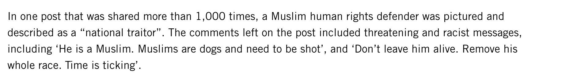
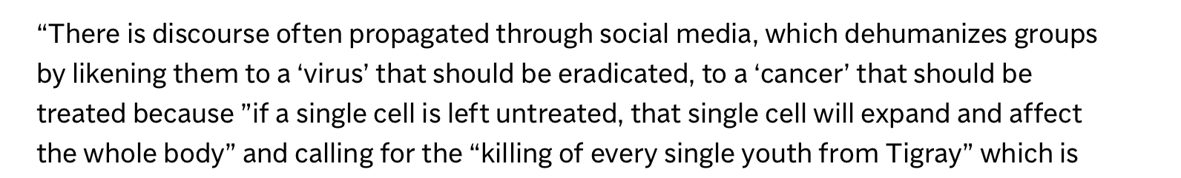

Slide 5

Problem Statement and Motivation
The Issue:
Proliferation of Toxic Behavior: Online discussions are increasingly marred by toxic behavior, ranging from personal insults to hate speech.
Impact on the Digital Ecosystem:
Deterred User Engagement: Toxicity in online spaces discourages participation and stifles healthy dialogue.
Affected Mental Well-being: Exposure to harmful content can have detrimental effects on individuals' mental health.

Slide 6
Problem Statement and Motivation
Consequences for Online Discourse:
Undermines Constructive Interaction: The presence of toxic comments erodes the quality and positivity of online conversations, making platforms less welcoming for users.
Our Objective:
Detect and Classify Toxic Behaviors: Utilize advanced machine learning techniques to identify various forms of toxic behavior, such as threats, obscenity, insults, and identity-based hate, within online discussions.

Slide 7

Problem Statement and Motivation
Our Goal:
Contribute to Safer Online Environments: By accurately detecting and classifying toxic content, we aim to empower platform moderators and administrators to take timely and effective action, fostering more respectful and engaging online communities.

Slide 8
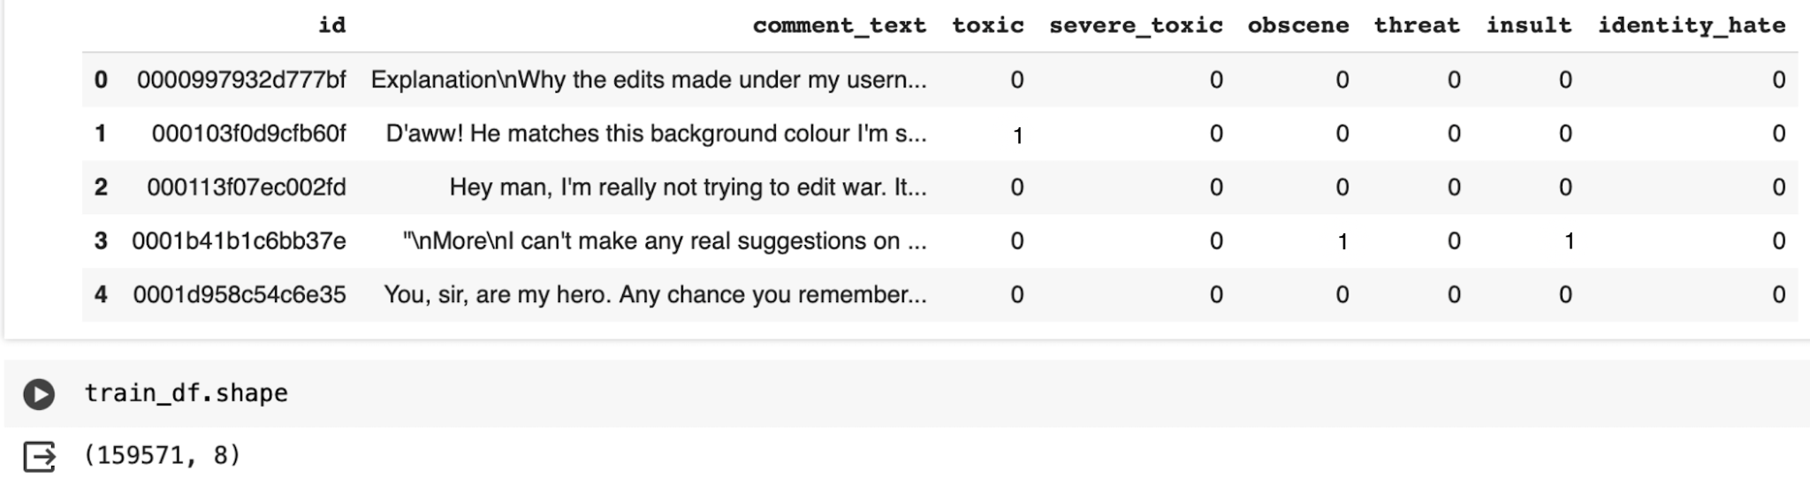
Dataset
Dataset Source: Kaggle's "Jigsaw Toxic Comment Classification Challenge," comprising comments from Wikipedia's talk page edits labeled for toxic behavior.
Dataset Description: The dataset consists of a large number of Wikipedia comments labeled by human raters for various types of toxicity, including toxic, severe_toxic, obscene, threat, insult, and identity_hate.

Slide 10
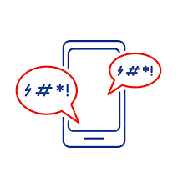
Dataset- Examples
Category: Toxic
Comment Text: Hey... what is it..@ | talk .What is it... an exclusive group of some WP TALIBANS...who are good at destroying, self-appointed purist who GANG UP any one who asks them questions abt their ANTI-SOCIAL and DESTRUCTIVE (non)-contribution at WP? Ask Sityush to clean up his behavior than issue me nonsensical warnings
Category: Identity Hate
Comment Text: You are gay or antisemmitian?
Category: Obscene
Comment Text: C*CKS*CK*R BEFORE YOU PISS AROUND ON MY WORK
Category: Threat
Comment Text: Hi! I am back again! Last warning! Stop undoing my edits or die!

Slide 11

Data Preprocessing
1. Text Cleaning:
Libraries Used: Utilize NLTK for natural language processing tasks and Python's re module for regular expressions.
Processes:
Normalization: Convert text to a uniform case (lowercase).
Noise Removal: Use regex (Regular Expressions) to eliminate URLs, HTML tags, and special characters.
Tokenization: Split text into words or phrases for analysis.

Slide 12
Data Preprocessing
2. Embeddings:
Purpose: To convert words into numerical form, capturing semantic meanings for model processing.
Libraries & Techniques:
FastText: Recognized for capturing subword information, useful for understanding suffixes and prefixes.
GloVe: Employed for its performance on aggregated global word-word co-occurrence statistics, offering a robust foundation for word embeddings.
Word2vec

Slide 13
Data Preprocessing
3. Visualization:
Tools: Utilization of Python's matplotlib and wordcloud libraries.
Applications:
Word Cloud Visualization: To identify and visualize frequent words and themes in the dataset, aiding in the understanding of common toxic patterns.
Dataset Balancing Visualization: Charts and graphs to assess and demonstrate the balance of classes within the dataset, highlighting any need for resampling or weighting strategies.

Slide 14
Data Preprocessing
4. Dataset Balancing:
Strategy: Address imbalances through oversampling, undersampling, or generating synthetic samples (e.g., SMOTE) to ensure the model learns from a balanced representation of classes.
Library: scikit-learn’s resampling module.

Slide 15
NLP Tasks & Models
1. Core Objective:
Focused on text classification to detect and classify toxic behavior across online platforms.
2. Multi-Label Classification:
Aim to categorize comments into multiple forms of toxicity, such as threats, insults, and hate speech, using a multi-label classification approach for nuanced understanding.

Slide 16
NLP Tasks & Models
3. Comparative Analysis Strategy:
Evaluating the efficacy of distinct model architectures in classifying toxic comments, aiming to discern the most effective approach based on performance metrics.
4. Models Under Comparison:
Hugging Face Transformers: Leveraging cutting-edge NLP capabilities for contextual understanding of text. Primary models include BERT and RoBERTa, renowned for their deep comprehension of language nuances.
CNN (Convolutional Neural Networks): Employed for their exceptional ability in pattern recognition and capturing local context within text, useful for identifying specific toxic indicators.
LSTM (Long Short-Term Memory) Networks: Chosen for their proficiency in handling long-range dependencies in text data, crucial for understanding extended contexts and subtleties in communication.

Slide 17
NLP Tasks & Models
5. Evaluation Criteria:
Performance: Accuracy in classifying various forms of toxicity.
Efficiency: Computational resources and time required for training and inference.
6. Implementation Details:
Utilizing pre-trained models from Hugging Face's repository tailored for NLP tasks, with fine-tuning on the toxic comment classification dataset.
Separate training sessions for each model architecture, ensuring a fair and unbiased comparison of their capabilities.
Analysis of results to identify strengths and weaknesses of each model in the context of toxic comment classification.

Slide 18
Challenges
Challenges in Toxic Comment Classification:
Imbalanced Data: Overcoming the disparity in the distribution of classes to ensure models do not become biased towards the majority class.
Interpreting Model Decisions: Enhancing transparency by understanding how models make classifications, critical for trust and accountability.
Subtleties of Language: Detecting nuanced toxic behavior that isn't overtly harmful but can be equally damaging, requiring deep linguistic comprehension.

Slide 19
Biases, and Ethical Considerations
Addressing Biases:
Mitigating Model Bias: Implementing strategies to prevent our models from perpetuating or introducing biases against specific groups or individuals, ensuring fairness in classification.
Ethical Considerations:
Free Speech vs. Toxicity Detection: Finding a delicate balance between detecting toxic behavior and upholding the right to free speech, acknowledging the fine line between harmful content and opinion.
Privacy Concerns: Safeguarding user privacy in data collection and model predictions, adhering to ethical standards and regulations to ensure respectful handling of user information.

Slide 20
Rough Timeline for Week 2
Day | Objective | Task
Day 1 | Initial Model Implementation | - Data preprocessing, finalize model architecture & start model training.
Day 2 - 3 | Model Training & Initial Evaluation | - Continue training, adjust parameters, evaluate with validation subset.
Day 4 | Analysis of Initial Results | - Collect evaluation metrics (accuracy, precision, recall, F1). - Conduct error analysis to identify weaknesses.
Day 5 | Addressing Roadblocks & Refining Model | - Apply changes from error analysis, add data/techniques, re-training/fine-tuning.
Day 6 | Preparing for Progress Update Presentation | - Compile information on implementation, results, challenges, update project timeline.

Slide 21
Thank you

